Slide 1

Do you run a business in Norfolk?
Have you heard of Business Continuity Planning?

Slide 2
Introduction
Running a business can be challenging at the best of times but have you ever stopped to wonder how you would cope should the unexpected happen?

Slide 3




What would you do if?
Your premises were flooded?
There was a major incident at an adjacent business and you were unable to access your premises?
Several of your key staff are off sick?
There was a power cut affecting your premises and those around you
One of your key suppliers experiences problems?

Slide 4
Business Continuity Plan
If you have already thought about some of these things and how you would deal with them then you have already taken your first steps towards creating a…
..Business Continuity Plan

Slide 5
Business Continuity Plan
Put simply, Business Continuity is the
process of thinking about your
business, the things which could
adversely affect it and putting
measures in place to deal with them
and recover.

Slide 6
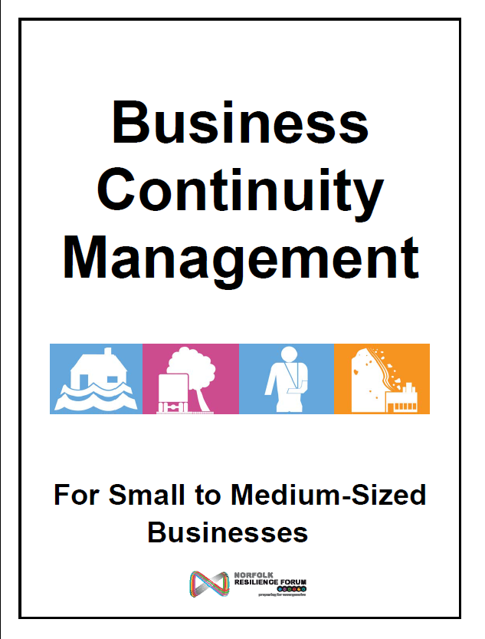
Business Continuity Management
Business Continuity Management (BCM) is about identifying parts of your business that you can’t afford to lose – such as
  information,
  stock,
  premises,
  staff –
and planning how to maintain these if
an incident occurs.

Slide 7
Business Continuity Management
This affects you whether you are
a market trader, a voluntary organisation,
a SME or a global institution you need
to be able to continue with your critical
activities, whatever happens.

Slide 8
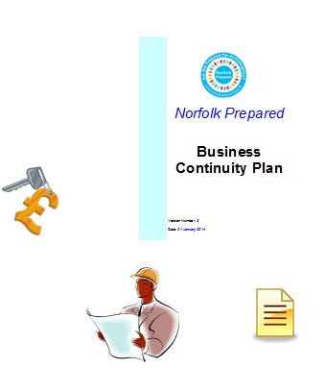
Business Emergency Kit
An Emergency Kit contains items that will help you implement your plans. Your kit should be stored safely and securely off-site. Example items:
  Your Business Continuity Plan,
  List of employees, contact details and next of kin information,
  Building site plan,
  Computer back ups,
  Spare keys / security code information,
  Insurance, finance and banking details.

Slide 9

Did you know..
Experience has shown that businesses with Business Continuity plans in place bounce back following an emergency far more quickly than those that don’t.
In fact, it has been shown that 80% of businesses without a plan simply cease trading following a serious emergency.

Slide 10

More information
Creating a Business Continuity Plan doesn’t have to be complicated! Don’t delay – start planning today.
There’s lots of helpful information on the Norfolk Prepared website.
Visit www.norfolkprepared.gov.uk and click on the Preparing your Business section.

